Slide 1

Good afternoon and welcome!

Slide 2


How do you keep up with online safety?
Notes:
[Include your welcome message here if applicable]
The internet is a massive part of our lives today – from our jobs to our children’s education and our downtime. As children grow up in a digital world with technology that’s increasingly changing and developing, it’s important that your child has a solid foundation for online safety.
Knowing when to recognise potential harms and how to keep themselves from being targeted can help ensure they experience more benefits than harm online.
This presentation is designed to give you a brief look at some of the issues children might face online and provide you with some tips and tools to keep them safe.

Slide 3

The positives of being online…
59%
3/4
of children say the internet has a positive impact on their wellbeing*
% of children who say spending time online makes them feel confident**
of children say the internet/tech is important for their independence**
*Internet Matters tracker survey, Wave 19 (2024)
**Children’s Wellbeing in a Digital World, Year Three, Internet Matters (2024)
Notes:
First, it’s important to remember that there are plenty of benefits for children who go online.
Research from online safety organisation, Internet Matters, found that the majority of children believe going online positively impacts their wellbeing. This is based on a survey given to children aged 9-17 who self-reported these feelings.
Other research from Internet Matters found that children who go online are increasingly confident; the stat on screen shows the change from 2022 to 2023. With so much information and opportunity for connection, this confidence could be related to finding spaces that support who they are and their interests.
Additionally, the same research found that 75% of 9-17-year-olds saw technology and the internet as an important part of their independence.
Overall, children enjoy going online, so our role as educators and yours as parents is to give them the tools to keep enjoying their time by staying safe and becoming resilient.

Slide 4

What they’re doing online…
70%
46%
36%
Source: Internet Matters tracker survey, Wave 19 (2024)
Notes:
Here are a few of the more popular apps among children, which is likely not all that surprising.
YouTube is consistently the most popular app across all age groups, but its popularity is particularly high among 11-14-year-olds. Research shows, though, that most children are viewing content rather than creating their own.
We can see that WhatsApp and TikTok are also quite popular. One thing that’s important to remember about these two platforms – and other social media platforms – is that users a required to be at least 13 to use them.
Using these platforms at a younger age or before your child is ready could leave them open to harm. Research shows that around two-thirds of 11-12-year-olds already use WhatsApp and one-quarter of 9-10s use TikTok, which means these children could be at greater risk for harm.
This is just a snapshot – other popular apps and platforms include Netflix and Disney+, Snapchat, Minecraft and Instagram. On the whole, as a child grows, the more likely they are to gravitate towards platforms that let them connect and communicate with others.

Slide 5
Real life data at Uplands
1.What technology do you have at home?
Laptop-44 Tablet-73 Smartphones-34 Games console-44
Smart T.V.-56
2. What technology do you use everyday? Laptop-13 Tablet-37 Smartphones-24 Games console-27
Smart T.V.-35
3.How do you watch T.V.?
T.V. 63 You Tube 51 Netflix 52 Amazon Prime 28 BBC IPlayer 33
4. Do you have a favourite UTuber? Yes 57 No 11
5. I feel safe when go online at home Yes 69 No 8
6. I feel safe when go online at school Yes 59 No 9
7. Have you ever seen anything online that has upset you? Yes 44 No 27
8. I know what to do if something upsets me online Yes 61 No 5
9. My parents monitor my online usage Yes 36 No 11

Slide 6
Device preferences by age
Source: Internet Matters tracker survey, Wave 19 (2024)
Notes:
In terms of the type of tech children use, younger kids often use tablets before graduating to smartphones and laptops or PCs. The use of video games consoles also increase by age, though older children tend to use games as a way to communicate and stay in touch with friends.

Slide 7


The potentially negative impacts…
Sleep cycles are often affected by blue light from too much screen use, which can impact their daytime activities like school;
Excessive screen use might result in less movement, leading to physical health issues
Platforms use persuasive design to keep people using it, which children are particularly vulnerable to
More time online means more opportunity to come across potential harms.
Notes:
Despite many positives, there are also potentially negative impacts from being online. For example, research shows that blue light from screens can impact sleep cycles, and using screens while sitting or lying down can have impacts on physical health.
Platforms also use what’s called persuasive design to keep people engaged. Children are often more susceptible to this, which can lead to feelings of too much screen time.
And the more time a child spends online, the more likely they are to come across potential harm. However, if they have the right skill, they can often identify these risks.

Slide 8


Smartphones vs normal phones
Internet access
Apps and games
Connection any time
A range of parental controls
No internet access
No (or few) apps and games
Messages and calls any time
Limited parental controls
Notes:
A common debate is about the age at which children should be able to use smartphones. These are mobile phones that can access the internet and have apps installed on them. Some parents have opted for ‘dumb’ phones, which are mobiles that usually only have text and call capabilities.
Every child is unique and so are their needs, so we can’t say which is better. That is a choice you need to make. Consider how you want your child to use their mobile. If it’s simply to stay in touch with you, a dumb phone might be enough. But if you want them to access homework or learning on their mobile, then a smartphone might be better.
Whichever you choose, make sure you involve your child in the process to help get them on board. If you do choose a smartphone, or if your child already has one, make sure you review the parental control settings or use a parental controls app so you can help them stay safe.

Slide 9



Common online safety issues
Notes:
We’re now going to focus a little on common online safety issues your child might come across online and things you can do to keep them safe.

Slide 10
Types of harmful risks
Contact | Content | Conduct | Commerce
Contact risks come with online communication. This could include cyberbullying and hate speech as well as grooming and sextortion. | Content risks come with image- and video-sharing online. It’s also in video games and music. This could include explicit or hateful language, violent videos, age-inappropriate games and pornography. | Conduct risks are the actions children might take that could lead to harm. This could include visiting porn sites, gambling platforms and chat rooms, or sending sexual images or texts. | Commerce risks come with online spending, advertising and scams. This could include clicking on ads in a mobile game, sending money to a harmful source or even receiving a phishing email.
Notes:
When it comes to risks, there are 4 C’s that are commonly referred to – they are contact, content, conduct and commerce. Contact risks are those that come from talking with other users online – including friends and strangers.
Content risks refer to potentially inappropriate videos, images, comments, TV shows, video games, etc.
Conduct risks are the actions children take online. Some vulnerable groups are more likely to face this risk. For example, research shows that children with physical disabilities are more likely to visit sites with adult content. In fact, vulnerable children such as those with special education needs, communication limits, care experience, physical disabilities and mental health difficulties all are more likely to face all of these types of risks online.
Finally, commerce risks tend to refer to scams but can also refer to general spending and overspending, particularly in video games that have optional purchases. If a child engages with scam advertising or phishing messages, they are likely to face some sort of harm.

Slide 11
Dealing with inappropriate CONTACT
What to talk about
Top tips & tools
Sometimes people hide behind fake profiles for dishonest reasons
Agree how they will respond to requests from people asking them for something/to do something
Never agree to meet up with anyone they don’t know in real life (or who makes them uncomfortable)
Set up safe social media profiles that don’t share personal information
Customise communication options in video games
Turn off geolocation settings on devices
Learn/teach your child how to report, block, mute and use any other similar tools
Notes:
There’s a chance that your child may meet people online who aren’t who they say they are. Grooming is a word used to describe people befriending children in order to take advantage of them for sexual purposes. Many parents worry about online grooming so it’s important to talk to your children about how to stay safe.
What to talk about:
Sometimes people hide behind fake profiles for dishonest reasons;
Agree how they will respond to requests from people asking them for something or to do something (especially things that are inappropriate or make them uncomfortable);
Never agree to meet up with anyone they don’t know in real life (or who they do know but who makes them uncomfortable).
While a lot of these cases relate to contact from strangers, it could also include people they know or friends from school. Most people online will not be harmful, but it’s important they know to approach communication with caution.
Top tips and tools to support children include:
Set up safe social media profiles that don’t share personal information
Customise communication options in video games
Turn off geolocation settings on devices
Learn how to report, block, mute or use any other such features, and teach your child when and how to do the same.

Slide 12
Dealing with inappropriate CONTENT
What to talk about
Top tips & tools
They can come to you if they see anything that upsets them
The importance of respect for each other and the meaning of consent
If they have seen online pornography, talk about the unrealistic image of sex and relationships it presents
Parental controls on home broadband
Content locks on mobile networks
Safe search on browser search engines (or use child-friendly search engines)
Content controls in the apps they use or games they play
Notes:
It’s possible that children may come across things online which are inappropriate for their age and stage of development. Tools like parental controls can help to protect your children from accessing inappropriate content, but you can’t check everything they see on the internet. The first step is to have regular conversations about what they do online and encourage them to talk to you if they see anything that upsets them.
What to talk about:
They can come to you if they see anything that upsets them;
The importance of respect for each other and the meaning of consent;
If they’ve seen pornography online, talk about the unrealistic images of sex and relationships it presents.
Top tips and tools to support children include:
Setting parental controls on home broadband networks;
You can set content locks on mobile networks as well;
Turn on safe search on your browser search engines (such as Google), or use child-friendly search engines like Swiggle;
You can also set content limits in the individual apps they use and games they play.

Slide 13
Dealing with inappropriate CONDUCT
What to talk about
Top tips & tools
Talk to a trusted adult if they experience anything upsetting online or if they’re not sure about something
Think carefully about sharing images or videos of others without permission
Every action they take creates a digital footprint, which creates a picture of who they are; so, be responsible.
Demonstrate healthy behaviour both offline and online
Block age-inappropriate websites on broadband or using parental controls apps
Report inappropriate posts or content on social media or other apps to web providers or the Internet Watch Foundation.
Notes:
The nature of devices is children can contact each other all the time. This also means that bullying isn’t something that can just happen at school.
The internet and social media has changed the way children interact and share their lives. It is really important to have regular conversations with them about what they share online. As a parent, it can be difficult to stay on top of all the different apps and sites that children are using, but there are simple things that you can do to make sure they become 'good digital citizen' and avoid sharing or saying something that they would later regret.
What to talk about
Talk to a trusted adult if they experience anything upsetting online or if they’re not sure about something (here, it’s also important for them to understand who trusted adults are to them – such as yourself or a grandparent or someone else who cares for them);
Think carefully about sharing images or videos of others without their consent or permission;
That every action they take online creates what’s called a digital footprint that follows them as they grow – and as they start applying to jobs or future opportunities. It creates a picture of who they are, so they should make responsible choices.
Top tips and tools to support children include:
Demonstrate healthy behaviour both online and offline;
Block age-inappropriate websites on broadband or using parental controls apps;
Report inappropriate posts or content on social media or other apps to web providers or the Internet Watch Foundation.

Slide 14
Dealing with inappropriate COMMERCE
What to talk about
Top tips & tools
Talk about scams, including what they could look like and the harm they could lead to
Encourage them to come to you or another trusted adult if they’re not sure if something is trustworthy
Avoid clicking on unknown links or responding to unexpected emails/text/WhatsApp messages
Stay informed about scams that your child could come across in social media or video games
Install cyber security software on your child’s devices – there are free and paid-for options available
Where relevant, set up parental controls that restrict spending or require a PIN so you can check purchases first.
Notes:
Children can come across scams on a range of platforms, including social media and video games. Some ads in mobile games are even designed to look like games, to encourage accidental clicks. These scams can lead to financial impacts as well as negative affects on children’s confidence and mental health.
What to talk about:
What scams are, what they might look like and the harm they could lead to;
Coming to you or another trusted adult if they’re not sure if something is trustworthy;
Avoiding clicking on unknown links or responding to unexpected emails, texts and WhatsApp messages – even if the sender claims to be someone they know.
Top tips and tools to support children include:
Staying informed yourself about scams that your child might come across on social media, in video games or in other digital spaces;
Installing cyber security software on your child’s devices – there are plenty of free and paid-for options. This software can flag potential scam content;
Setting parental controls or PINs to restrict spending in games and apps so that you can confirm and complete the purchase after checking that it’s legitimate.

Slide 15
Risk is not harm
While risk-taking can lead to harm, it more often results in children discovering new passions and abilities.
Positive actions can limit risks from becoming harmful. Here are 5 tips:
Understand the risks
Communicate regularly
Keep risks in proportion
Agree on helpful mediation strategies
Develop coping strategies to foster resilience
Notes:
Although we mentioned some harms that could come with the risks we just talked about, it’s really important to remember that risk does not always equal harm. A child riding their bike without training wheels is a risk, but it often leads to more confidence and independence. This is true for a lot of online activities as well.
These positive actions can limit risks from becoming harmful:
Understand the risks and the likelihood of them leading to harm;
Communicate regularly with normal conversations about your child’s digital life – in the same way you might ask about their day at school;
Keep risks in proportion. Although you might worry about online harms, for example, taking away their device is often more harmful than good as you also take away the benefits they experience.
Agree on helpful mediation strategies with your child for if a risk starts to feel harmful – such as talking to you or using block and reporting features.
Develop coping strategies to foster resilience. Again, this could include blocking or reporting content or users, or it could be taking a screen break or limiting their time online.

Slide 16
Children who have experienced online issues
Source: Internet Matters tracker survey, Wave 19 (2024)
Notes:
Internet Matters’ 2024 survey with children asked them about the issues they experienced in the past year. These are some of the issues with the largest number of children saying they experienced them.
Let’s look at a few of them more closely.

Slide 17
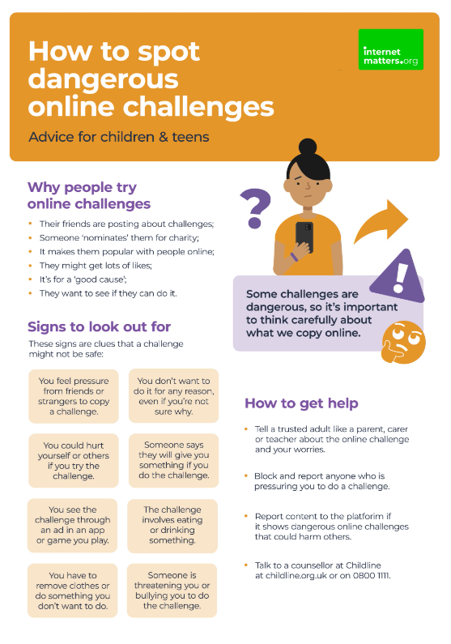
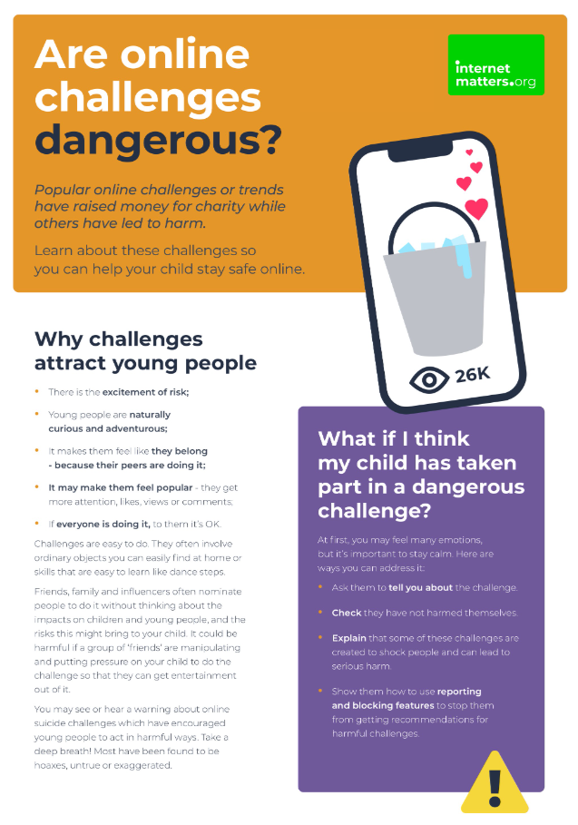

Dangerous online challenges
Viral online trends attract many children and teens
Most are harmless, but some can be dangerous
1 in 5 children say they’ve come across content which promotes dangerous stunts or challenges
It’s important to talk with your child so they understand the dangers and can avoid potential harm.
Notes:
You might have seen some online challenges and trends recently, or you might remember trends like planking and flash mob dances that were popular years ago.
These types of challenges attract many children but while most of them are harmless, some can be dangerous.
In Internet Matters’ survey, around 1 in 5 children aged 9-17 said they had come across content that promoted dangerous stunts or challenges. It’s important to remember that this is self-reported, and some children might see this content without realising it’s dangerous.
You’ll see a lot of these trends on social media, so it’s really important that you talk to your child about dangerous challenges. You can find more guidance about how to safely talk about this issue at InternetMatters.org or by scanning the QR code on screen.

Slide 18



Online bullying (cyberbullying)
Online bullying is more difficult to escape than ‘traditional’ bullying
It can happen between friends or strangers
It can happen in video games, on social media, in messaging apps, etc.
About 1 in 10 children say they have experienced online bullying. This increases for children with SEN needs or similar vulnerabilities.
Set parental controls, talk about healthy behaviour and show your child how to block and report content.
Cyberbullying conversation guide
Notes:
A common issue that a lot of parents worry about is cyberbullying (or bullying that happens online). The biggest thing to remember about it is that it’s so much more difficult to escape than ‘traditional’ bullying. And, actually, a lot of offline bullying then continues online.
Cyberbullying can happen between friends or strangers and can happen on social media, in video games, through messaging apps, in comment sections, and basically anywhere where people interact with others.
About 1 in 10 children say they have experienced online bullying, and this number increases with children who have SEN needs or similar vulnerabilities.
Talking about cyberbullying, including what it looks like and how to take action against it, is important. If you scan the QR code, you can access Internet Matters’ conversation guide.
You can also set parental controls to limit contact, customise disallowed words and show your child how to report or block bullies.

Slide 19

Inappropriate content
27% of children see pornography by age 11
Around 1 in 10 children report seeing pornographic or violent content online. This increases with age.
Children with vulnerabilities are more likely to come across these things – especially violent content.
Parental controls can help limit access to certain websites, content and more. It’s also important for your child to report any inappropriate content they accidentally come across.
Notes:
The Children’s Commissioner for England ran a survey which found that over a quarter of children had seen porn by age 11; 10% had seen it by age 9. And the average age children first see pornography is 13. This could be through curiosity or stumbling across the content by accident through ads on other websites. Their friends might also share this content with them.
An Internet Matters survey of children aged 9-17 found that 1 in 10 reported seeing pornography or violent content online. As children grow and if a child has SEND needs – including autism, sensory impairments, communication needs, ADHD and even dyslexia or physical disabilities – they are more likely to come across this content.
Unfortunately, if children see a lot of this content, they can become desensitised, which means it’s harder for them to recognise when something is harmful. So, setting parental controls on broadband and mobile, talking to them about why some content is not appropriate and showing them how to use reporting tools is really important. Especially if inappropriate content makes its way through a filter that should have stopped it; this helps the platform strengthen these filters and protect users who do not want to see such content.

Slide 20

Spending too much time online
41% of children believe they spend too much time online
Of these children, most reported it causing them some distress, upset or harm
Not all screen time is negative, but if your child’s wellbeing is negatively impacted, they need your support.
Most games and apps have screen time controls to manage this, but you should also help them find other activities to make their time online positive.
Guide to
balancing screen time
Notes:
The last issue we’ll look at today is spending too much time online.
Internet Matters asked 9-17-year-olds to identify issues they’ve experienced online. Of the 25 options, 41% said they spent too much time online – and this was the most highly reported issue of all listed.
As much as parents often think their children spend too much time online, this research shows that children recognise this as well. They just might not yet have the ability to regulate themselves to have a more balanced digital experience, which is why it’s important to set parental controls and screen time limits in their apps and games.
It’s also important to help them use their devices for a range of purposes such as learning and creating rather than just consuming content.
You can scan the QR code for Internet Matters’ guide to balancing screen time if you need more support.

Slide 21
3 things to teach your child
Be a confident communicator
Be a critical thinker
Be a capable tools user
Notes:
There is a lot to remember about online safety, but when it comes to teaching your child, these are the top things to remember:
Teach them how to be a confident communicator. You can do this by having those regular conversations and making chats about digital a normal part of conversations. The more they talk, the more confident they will feel voicing their concerns or asking for help.
Teach them to think critically about things they see online. This means questioning what they see and the intent behind it, checking for sources, asking your opinion and generally taking the time to think about the consequences of an action before they take that action.
Teach them how to use safety tools like reporting and blocking as well as customisation tools so their social media feeds and YouTube algorithms only show what they want to see. This also means knowing how to use their apps’ privacy and security settings.

Slide 22



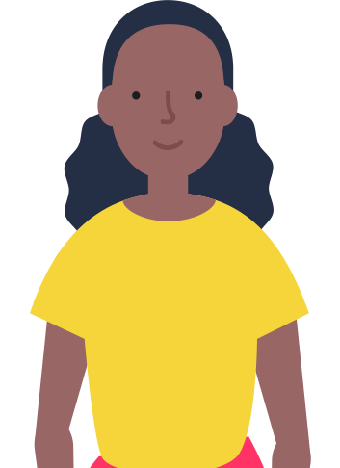

Create your family’s digital toolkit
Get resources based on your child’s age, devices, interests and needs along with your concerns.
Learn about the popular apps and platforms your child uses and see how to set parental controls.
Learn how to deal with any issues or harmful risks your child might face.
Create your digital toolkit
Notes:
A really great tool to help you teach your child these skills is the digital toolkit from Internet Matters. It works by asking questions about your child’s age, devices they use, their interests and their needs as well as your own concerns, then generating a list of relevant resources that can support you on all that you entered.
You’ll be able to save the toolkit and revisit it whenever you have a moment to learn a little more or have a question about something. You’ll find information on online safety issues and parental controls available with your child’s devices or apps.
Scan the QR code or search ‘digital toolkit’ at internetmatters.org to create yours.

Slide 23




More support available at InternetMatters.org
Or on social media:
        /InternetMatters
        @IM_Org
        @InternetMattersOrg
        @InternetMatters
        Keeping children safe online | NSPCC
Notes:
If you want more information about anything we spoke about today or just want to have a look around at the online safety resources available, visit internetmatters.org or follow them on social media.
[Add any additional information or your goodbye message if relevant]

