Slide 1

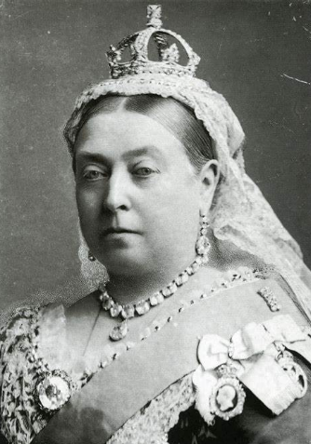
Year 3 and 4 Victorian Knowledge Organiser Quiz

Slide 2
When did Victoria begin her reign?
1836
1838
1837
1937

Slide 3
How long was Queen Victoria’s reign?
10 years
60 years
65 years
64 years

Slide 4
Which of these jobs did poor children have to do during the Victorian era?
Build chimneys
Shop keeper
Chimney sweep
Computer programmer

Slide 5
What did lots of Victorians do on a Sunday?
Visit friends
Go to church
Play games
Go to the cinema

Slide 6
Which Act of Parliament ended child labour?
The Children’s Act
The Mines Act
The Child Labour Act
The Education Act

Slide 7
How old was Queen Victoria when she died?
91
81
89
82

Slide 8
Who took over as King or Queen after Queen Victoria?
Elizabeth II
Edward VII
Edward VIII
Henry VIII

Slide 9
Incorrect
Try again

Slide 10
Correct!
Well done!
Next question

Slide 11
Incorrect
Try again

Slide 12
Correct!
Well done!
Next question

Slide 13
Incorrect
Try again

Slide 14
Correct!
Well done!
Next question

Slide 15
Incorrect
Try again

Slide 16
Correct!
Well done!
Next question

Slide 17
Incorrect
Try again

Slide 18
Correct!
Well done!
Next question

Slide 19
Incorrect
Try again

Slide 20
Correct!
Well done!
Next question

Slide 21
Incorrect
Try again

Slide 22
Correct!
Well done!
End quiz

Slide 23
Well done on completing the Victorian era quiz

