Slide 1
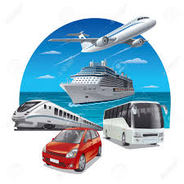
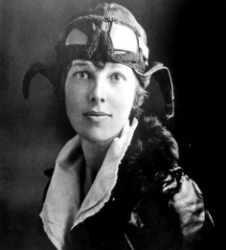

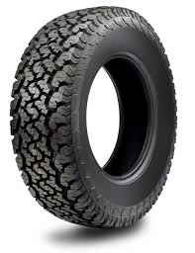
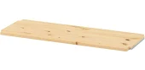
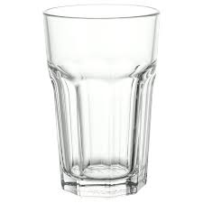
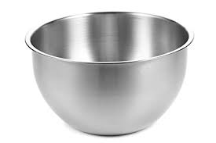
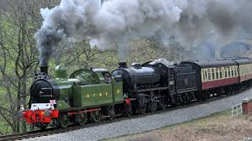
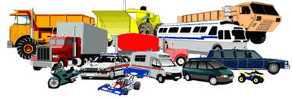
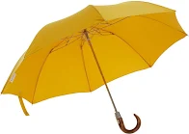
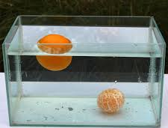
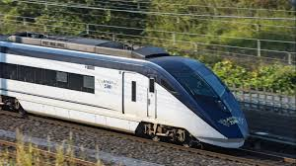
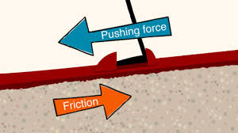

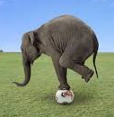
Brum Brum, Beep Beep
Transport is a
way of moving
people or
things from one
place to another.
A vehicle is something that moves people or things on land.
Friction is what happens when one thing rubs against another .
Materials
Properties of Materials
Floating
Waterproof Sinking
Transparent Strong
Amelia Earhart was
the first woman to
fly alone across the
Atlantic Ocean.
Old train
Steam
New train
Electric
Wood
Plastic
Rubber
Glass
Metal

