Slide 1

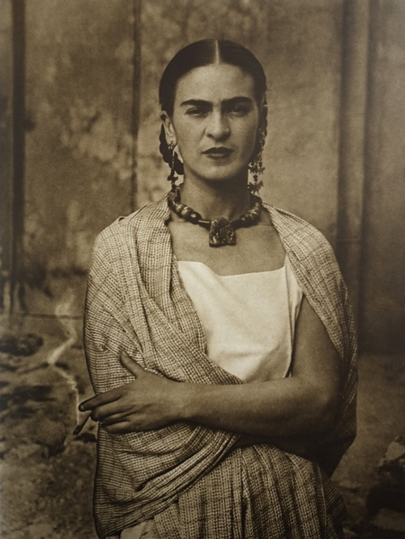
Frida Kahlo
Born | 6 July 1907; Coyoacán, México City, México
Died | 13 July 1954 (aged 47); Coyoacán, Mexico City, Mexico
Nationality | Mexican
Education | Self-taught
Profession | Painter
Movement | Surrealism; painting about dreams and what happens when we dream

Slide 2
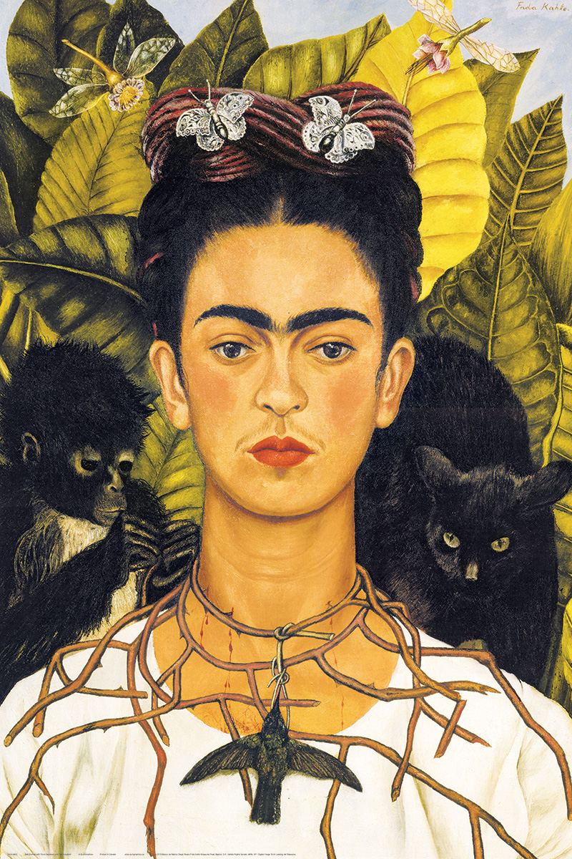
When she was a child she loved to draw and preferred to be alone drawing than spending time with her sisters.
When she was 6, she caught a disease called polio, this left her with problems with her leg and then when she was 18 she was in a terrible bus accident. Because of these accidents she was constantly in pain for the rest of her life and she would have to spend much of her life resting in bed. This didn’t stop her from painting and while in bed she drew and painted what she felt and saw. Much of the pain she suffered she put into her paintings.

Slide 3
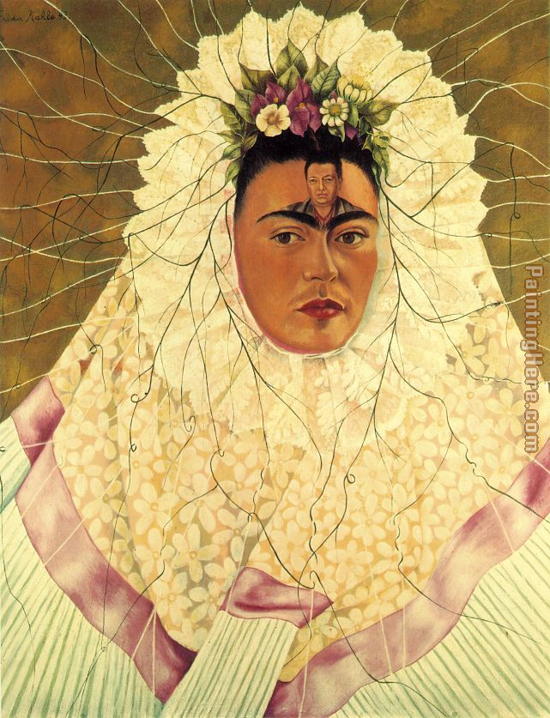
She later married another famous Mexican Artist called Diego Rivera they both continued to be very successful artists. This was even more impressive because at the time people didn’t always like women being artists. Her paintings showed how Frida thought and felt and are very personal.
Frida was always a strong voice for women in Mexico and around the world. When she was alive women did not have as many rights as they do now. She was also known for supporting the rights of indigenous people in Mexico.

Slide 4
Frida Kahlo was most known for her self-portraits. These are paintings that Frida painted of herself. She didn’t just paint herself but also added things around her in the painting. These were not just to make the painting pretty but everything she had in the painting related to something about her.
self-portrait: a portrait that an artist produces of themselves.
What can you see in this self-portrait?
What do you think these things represent?
What sort of animal is a monkey?
What is around her neck?
What type of animal is behind her?
What do you think of when you see leaves?

Slide 5
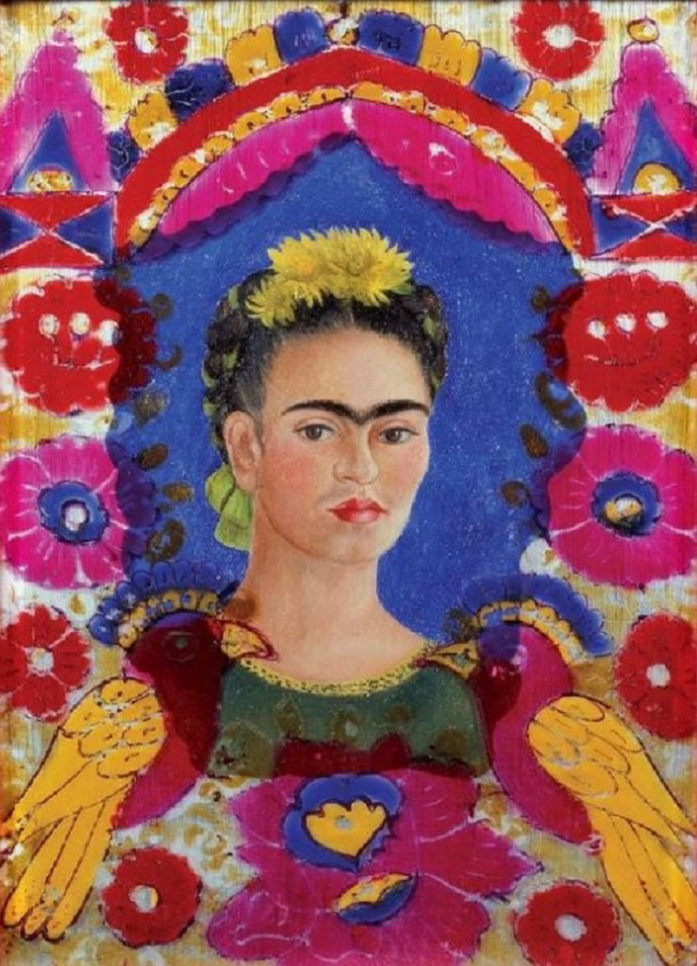
As we know Frida painted lots of self portraits, but she also included herself some of her other paintings. This is one of her self portraits called ‘The Frame’, Frida has drawn herself in the middle of a very colourful frame.
Think about why Frida drew the frame like this.
What would you add to your frame? What do you like? What do you want people to know about you?

