Slide 1
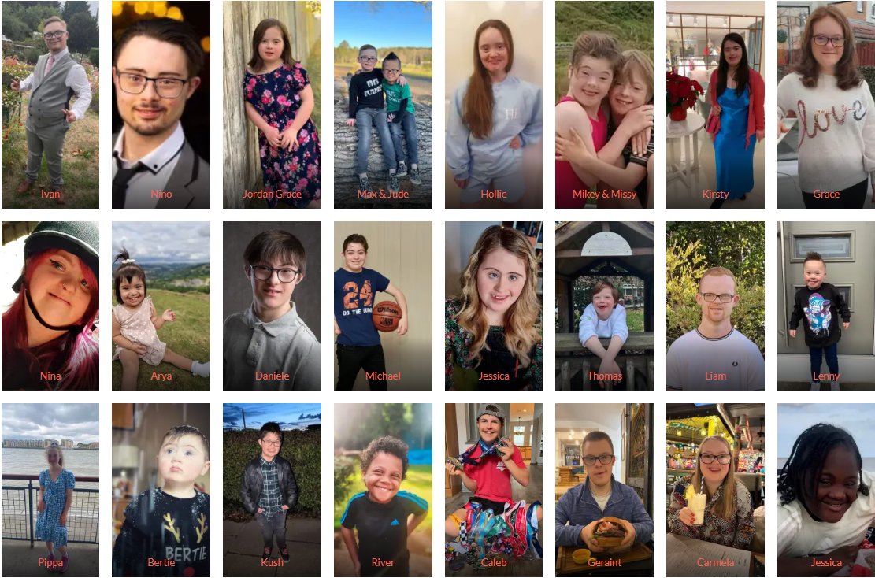

Slide 2
UPLANDS’ CELEBRATION OF
WORLD DOWN SYNDROME DAY
21.3.2024
Let’s celebrate our differences – everyone stand up and show everyone your colourful clothes and odd socks - wave your ankles. Diverse socks, diverse clothes, diverse people.
PARTNER TALK – WHAT DO WE ALREADY KNOW ABOUT DOWN SYNDROME?
WHY ARE WE CELEBRATING WORLD DOWN SYNDROME DAY AT UPLANDS, TODAY?

Slide 3
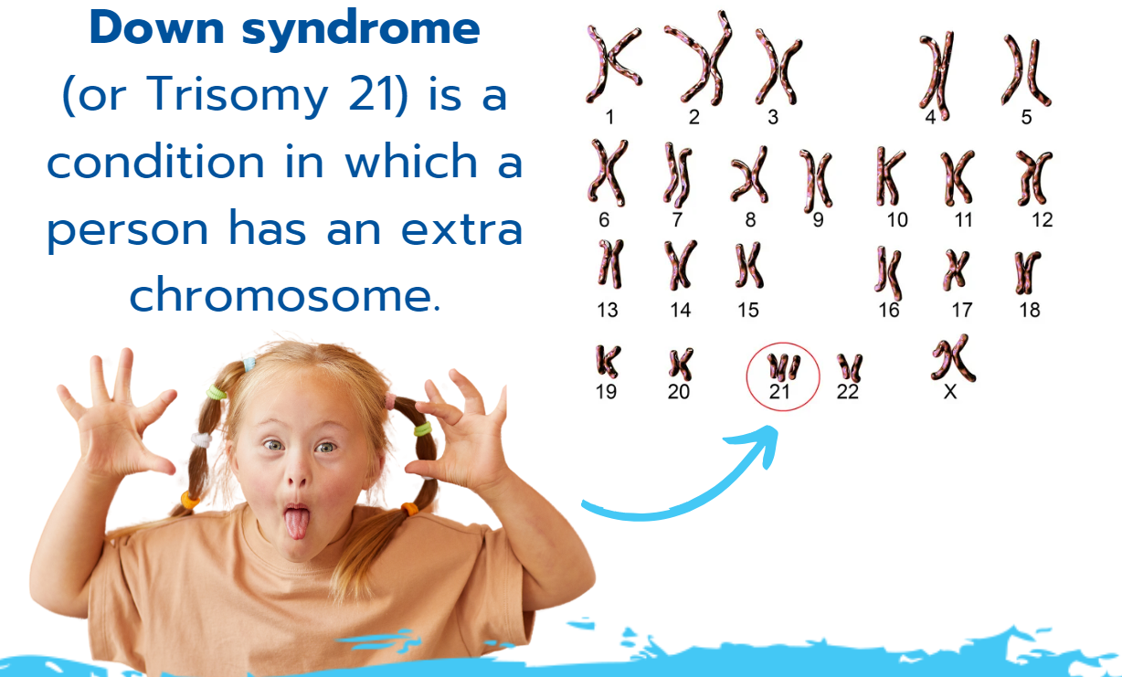
WHAT ACTUALLY IS DOWN SYNDROME??
3 COPIES OF THE 21ST CHROMOSOME, SO 21.3
What is a chromosome?
The genetic building blocks that make you YOU
Pictures of chromosomes look a bit like hanging socks, hence using odd socks to represent the uniqueness of people with Down Syndrome

Slide 4
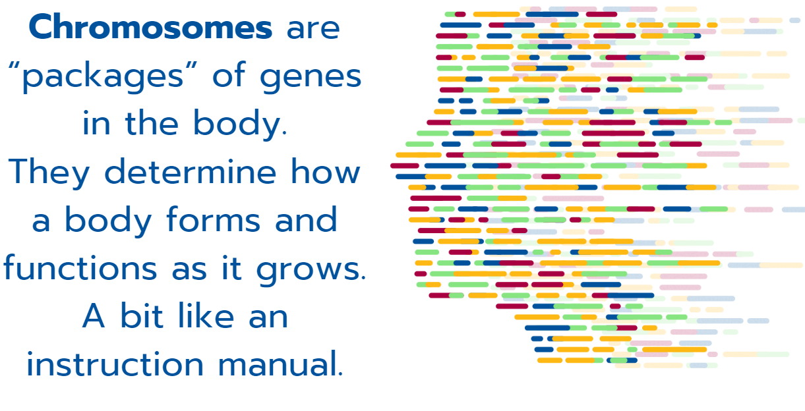

Slide 5
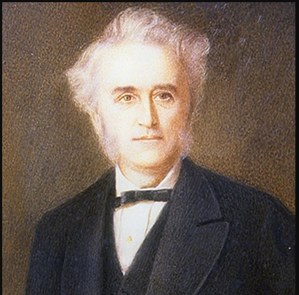
WHY ‘DOWN’ OR ‘DOWN’S’ SYNDROME?
Doctor John Langdon Down first identified and classified the set of characteristics about 160 years ago
In some countries, Down syndrome is known simply as Trisomy 21 or T 21 (trisomy meaning 3 copies). It is nothing to do with being ‘down’ in any way.

Slide 6
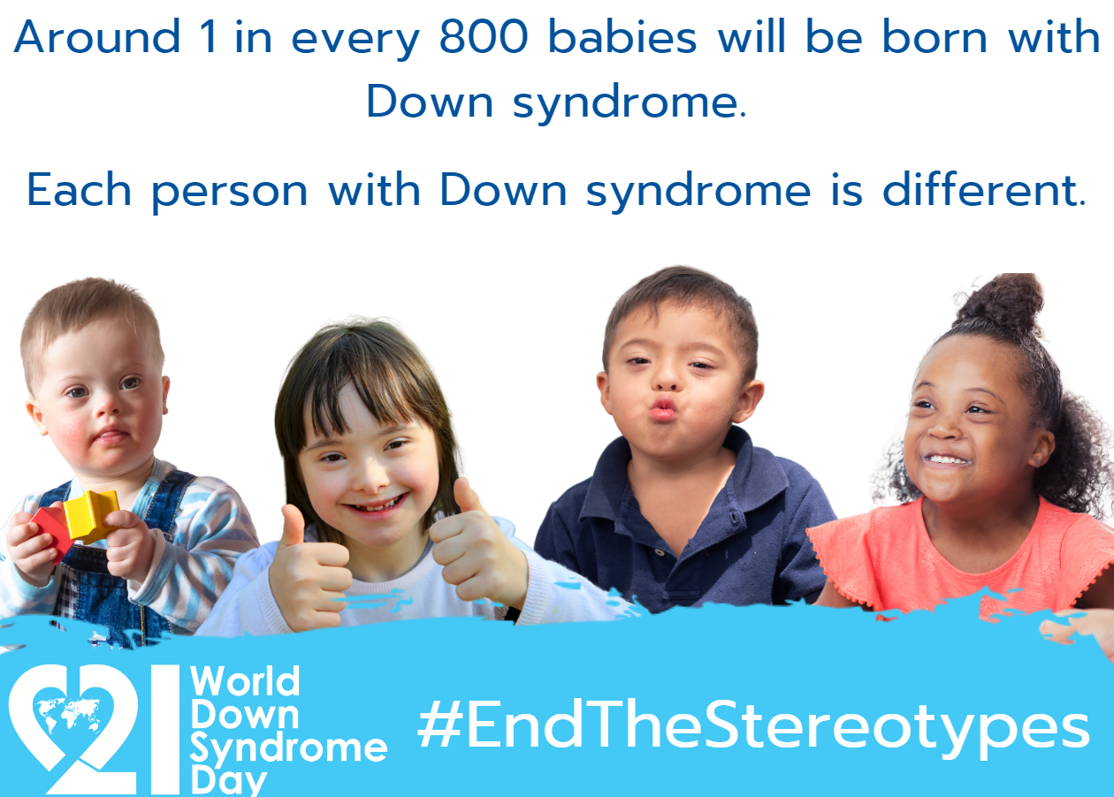

Slide 7
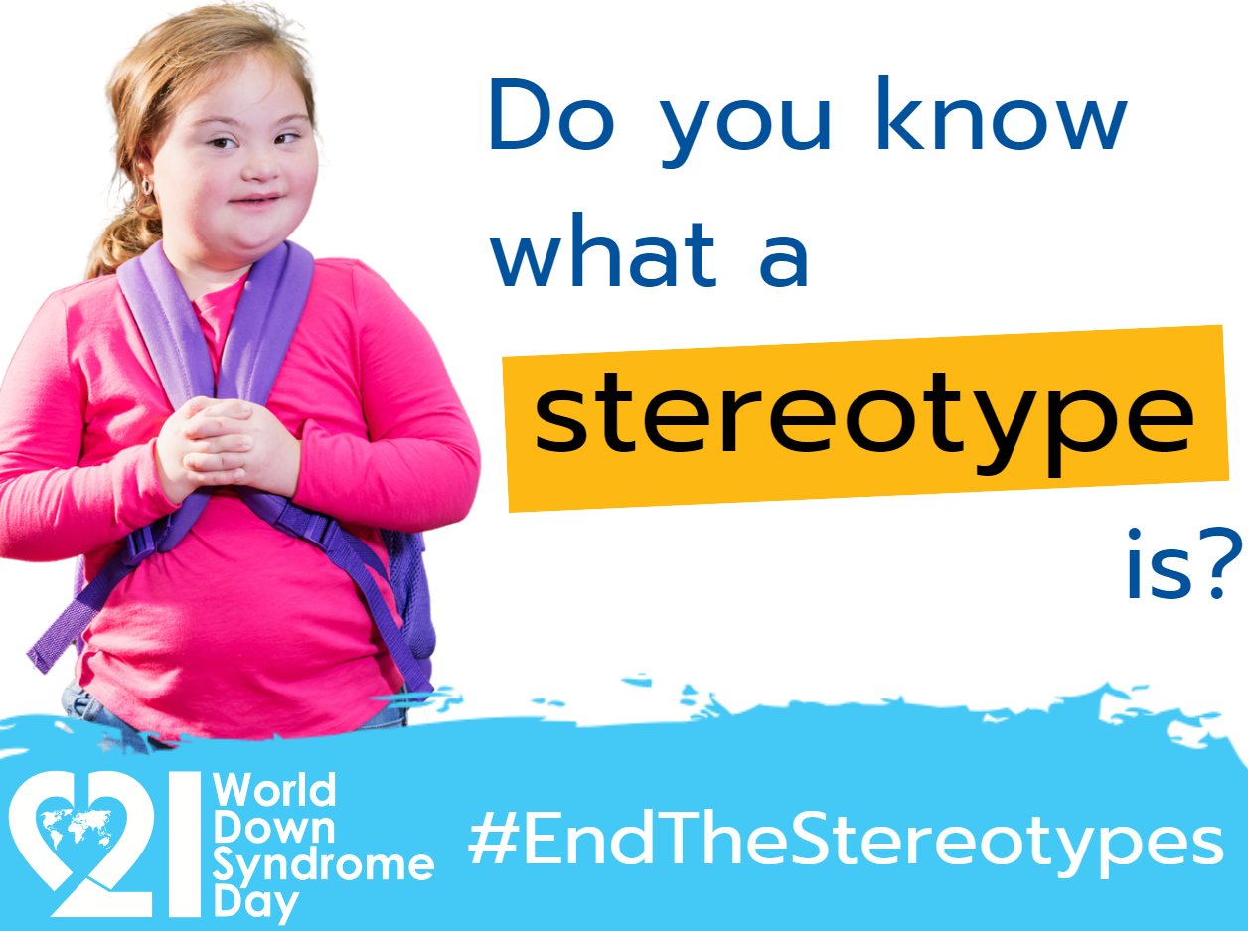
Wdsd 2024 ‘end the stereotypes’ – what does that mean for us at uplands?

Slide 8
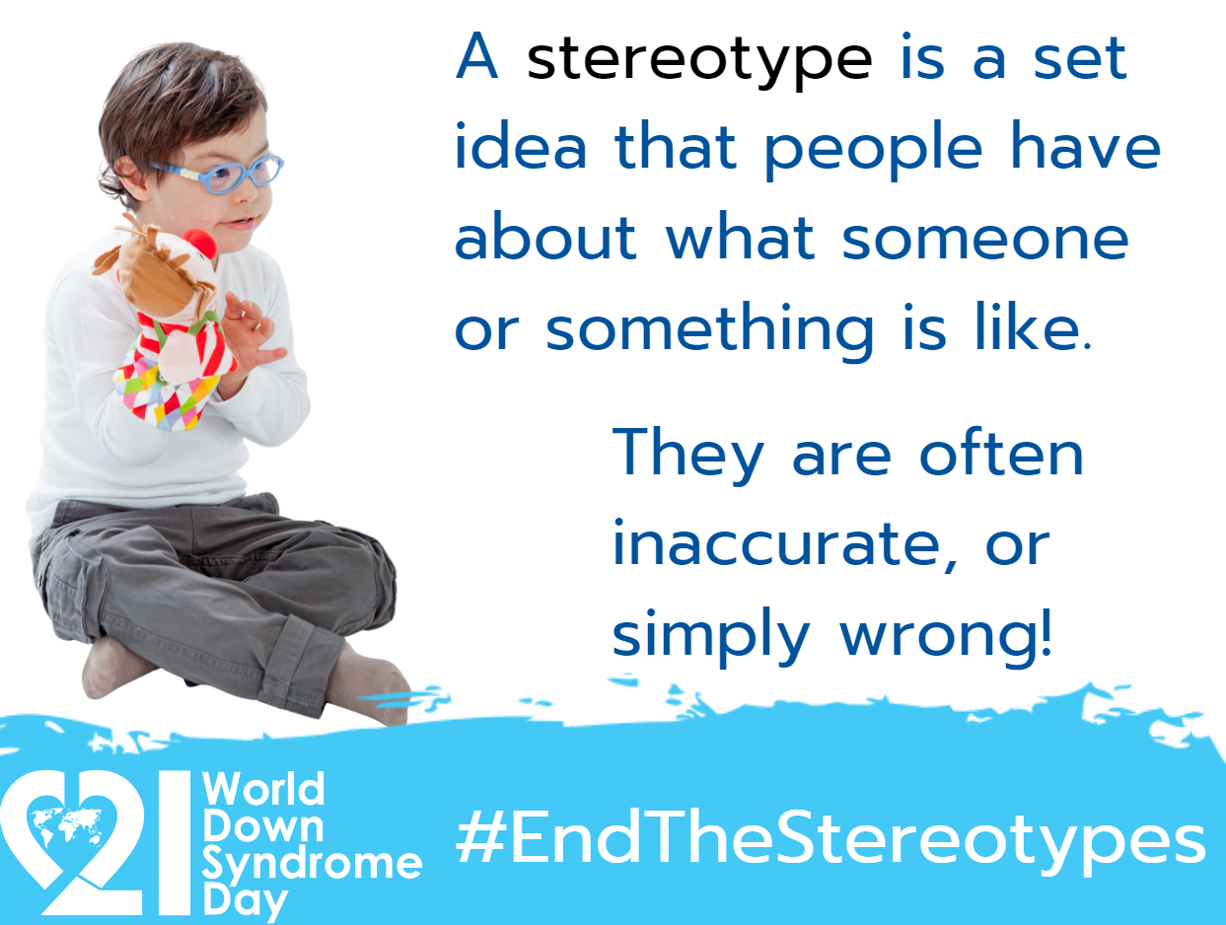

Slide 9
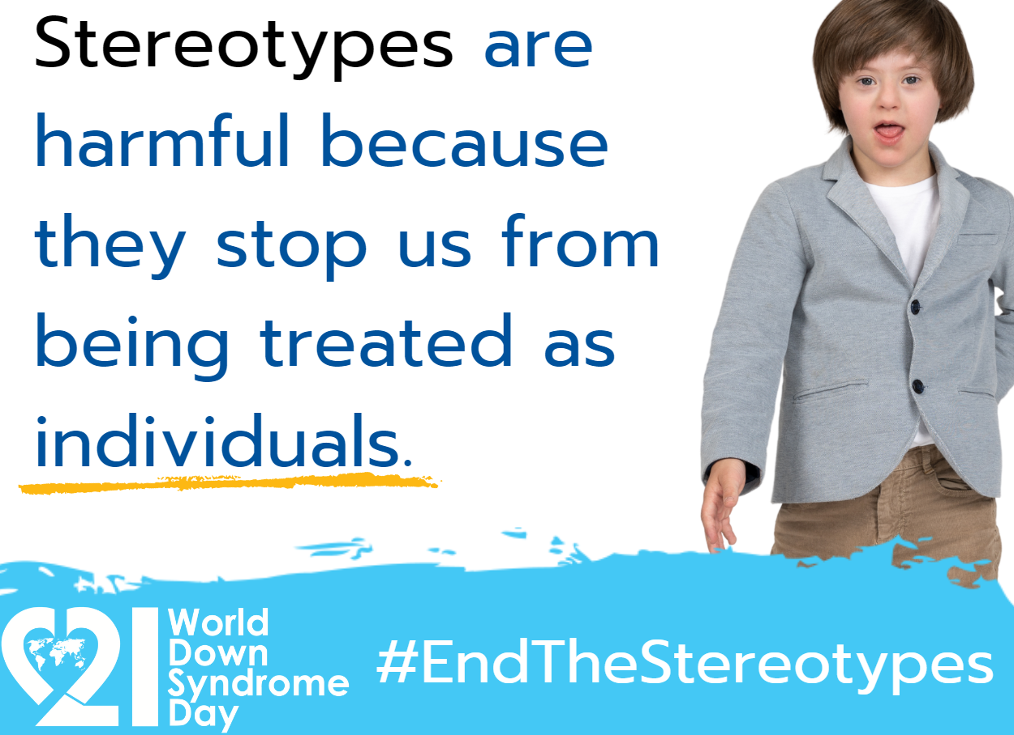

Slide 10
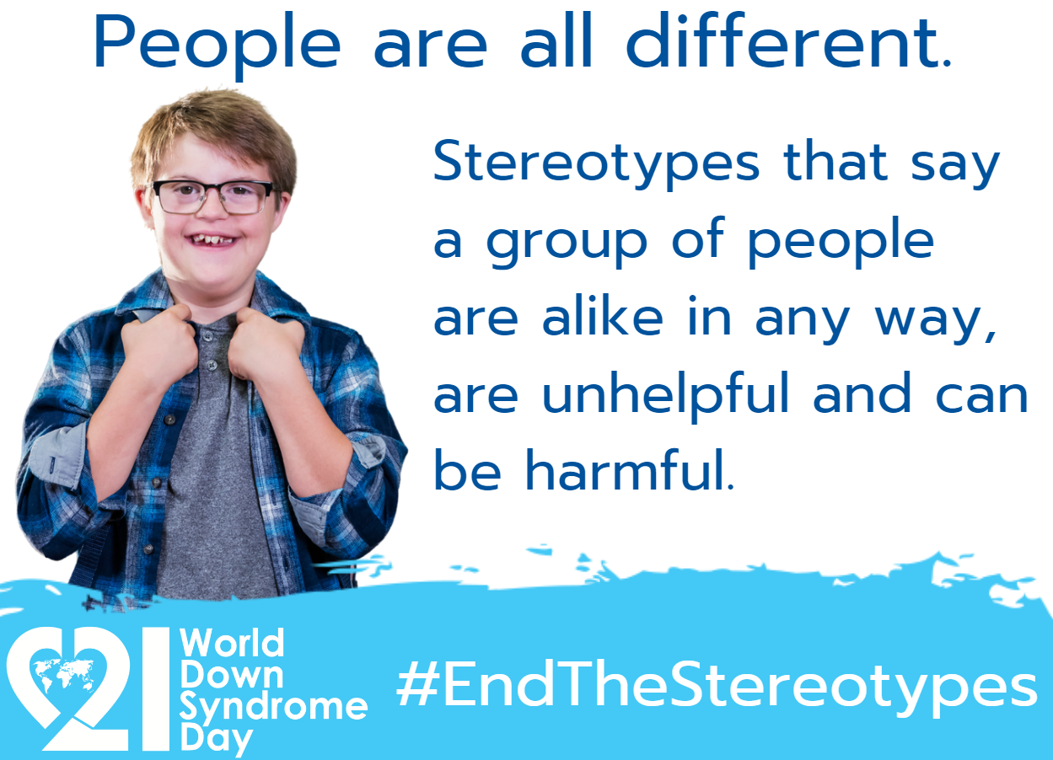

Slide 11
“assume we can ! "
Many people with Down syndrome around the world don’t have access to good education
Many aren’t given good health care
Many aren’t given the opportunity to live independently
Many aren’t given the right to choose how they live and what they do

Slide 12
Down’s syndrome/down syndrome/t21 is a condition, not an illness.
When asked, people in the DS community prefer to use ‘people first’ language – so we would say a child with Down syndrome, not a Down syndrome child.
A quick (1 min 30) video from the Down’s Syndrome Association-
https://youtu.be/9dUWkETZ9lg
Alternative link, vid on right.. https://www.downs-syndrome.org.uk/our-work/campaigning/world-down-syndrome-day/

Slide 13
Does anyone know anybody with down syndrome?
It can be easy to stereotype people with learning disabilities.
Like other conditions, Down Syndrome is a “spectrum" condition, with varying levels of support needs.
Many people with Down Syndrome will live independently when they grow up, just like you. Many will need a little help with day to day activities like shopping and cooking.
Some people with Down Syndrome will study at high level and go to university. Some will always need support with communication and living skills.
EVERY SINGLE HUMAN BEING IS VALUABLE – YOU DON’T NEED TO ACHIEVE ‘GREAT’ THINGS TO BE VALUED AND LOVED

Slide 14
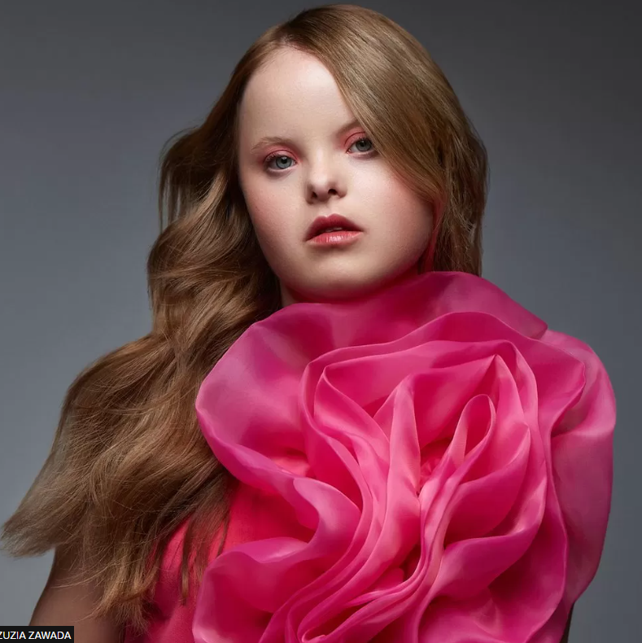
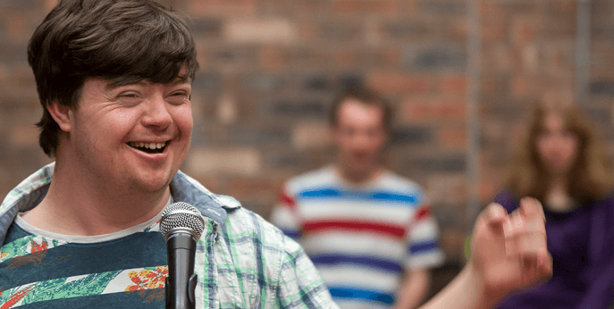
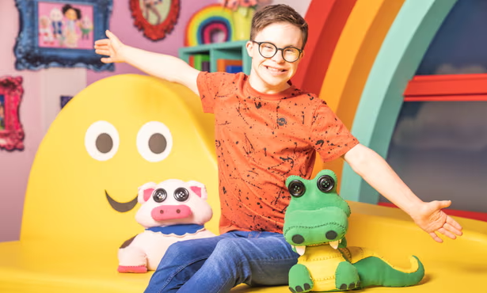
Liam Bairstow, an actor in UK soap opera Coronation Street
Beth Matthews, fashion model, has appeared in Cosmopolitan magazine
George Webster, Ceebeebies presenter
“I have an extra ingredient, a sparkling of magic inside. Some people, they say that I’m special, but that’s not what I think … You see, we’re made of different ingredients that help us shine like a star. My glow is what makes me who I am, and yours will make you who you are.”

Slide 15
and here are many people with down syndrome who live wonderful, ordinary lives

Slide 16
Every day life at uplands….
Idgy can understand more than he can speak, so just speak to him the way you would a typical kid in reception – remember not to use the word ‘’normal’’ – there is no such thing as normal!
One of Idgy’s favourite things is to make up games and inventing words and sounds, but sometimes he can be a little difficult to understand… so we can use….

Slide 17
MAKATON! AND THIS IS WHERE YOU ALL COME IN
I’m trying to understand
Can you say it again
Would you like to play? Yes no please/thank you/youre welcome from Moana
Game – remember Idgy will probably join in much better if there aren’t set ‘rules’ – he likes to create games!
Again? Different game?
Questions words – who what why where when how
Makaton with Lucinda – favourite https://www.youtube.com/watch?v=SjD6xn9cgnY
Songs – alphabet, rainbow, Goldilocks
Anything you want to look up using MAKATON – look at youtube

Slide 18
BYE EVERYONE – EXIT TO GEORGE WEBSTER ON STRICTLY
https://www.youtube.com/watch?v=LZ9fhuGLGaM

