Slide 1
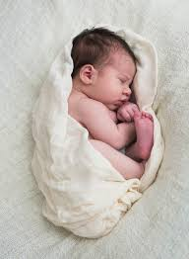
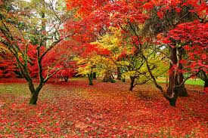
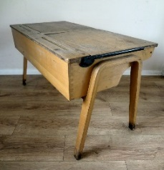
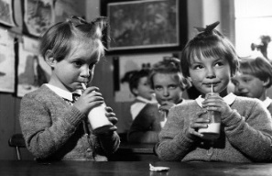
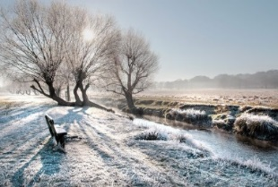
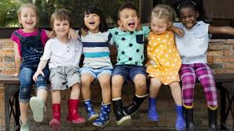
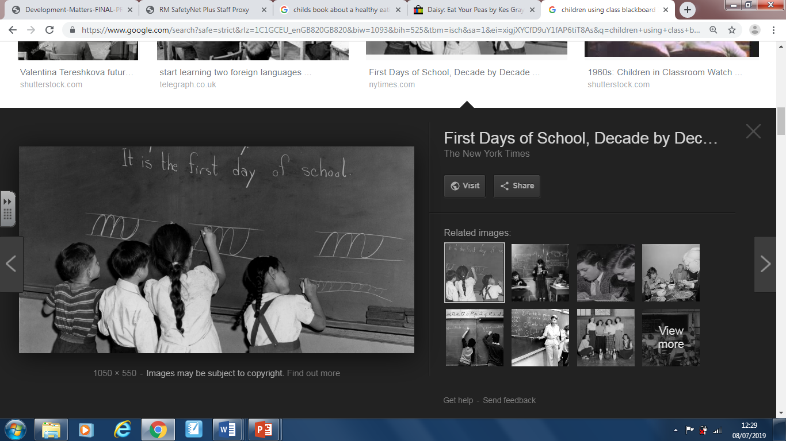
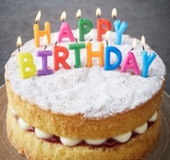
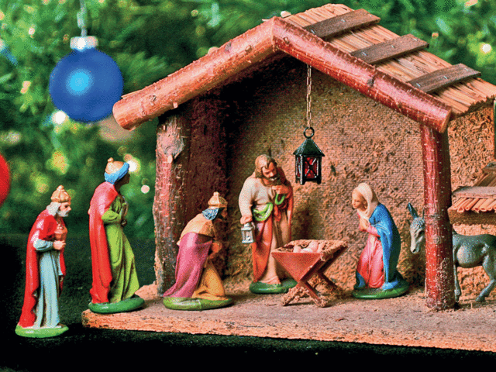
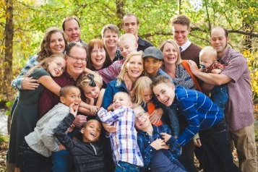
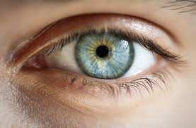
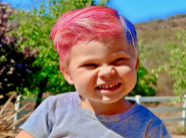
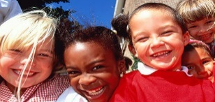
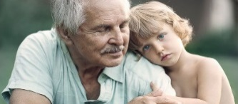
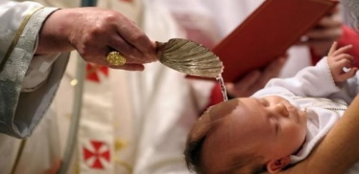
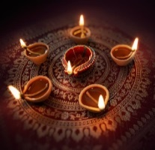
This Is Me
Changes
When I was a baby…
I drank milk.
I couldn’t walk.
I couldn’t talk.
Me now….
I can eat and drink different food.
I can move in different ways.
I can talk.
Changes
In Autumn…
It gets cooler.
The evenings get darker.
Leaves change colour and fall off the trees.
In Winter…
It is very cold.
There are no leaves on the trees.
Some animals hibernate.
Changes
School in my grandparents time.
milk
desk
blackboard
Similarities and Differences
All people look different.
Similarities and Differences
All families are different.
Similarities and Differences
People celebrate special times.
Birthday
Christmas
Eye Colour Hair Colour
Parents Grandparents
Aunties Uncles Cousins Step- families Brothers Sisters
Skin Colour Age
Infant Baptism
Diwali

Slide 2
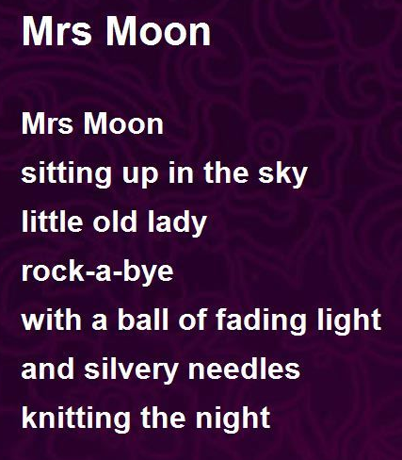
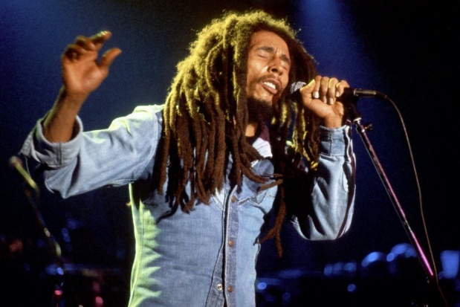
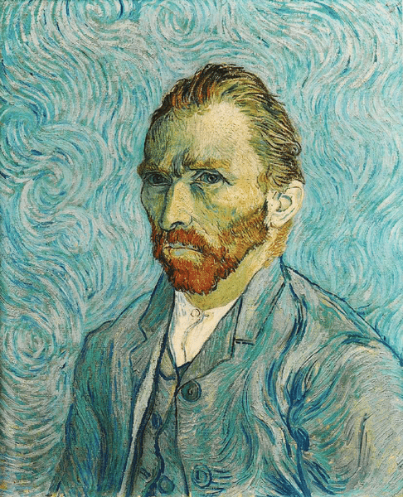
This Is Me
Poem of the term
Mrs Moon by Roger McGough
Musician of the term
Bob Marley
Artist of the term
Vincent Van Gogh

